Slide 1
Programming Fundamentals
Lecture 19
Ms. Farah Younas

Slide 2
Agenda of Lecture
Returning value to calling function
Overloaded function

Slide 3
Returning value from a function
When a function completes its execution, it can return a single value to the calling program.
this return value consists of an answer to the problem the function has solved
The next example demonstrates a function that returns a weight in kilograms after being given a weight in pounds (see example returning value to calling functions)

Slide 4
Returning value from a function
When a function returns a value, the data type of this value must be specified.
The function declaration does this by placing the data type, float in this case, before the function name in the declaration and the definition.
Functions in earlier program examples returned no value, so the return type was void.
the function lbstokg() (pounds to kilograms, where lbs means pounds) returns type float,so the declaration is float lbstokg(float);

Slide 5
Returning value from a function – return statement
The function lbstokg() is passed an argument representing a weight in pounds, which it stores in the parameter pounds.
It calculates the corresponding weight in kilograms by multiplying this pounds value by a constant; the result is stored in the variable kilograms.
The value of this variable is then returned to the calling program using a return statement.

Slide 6
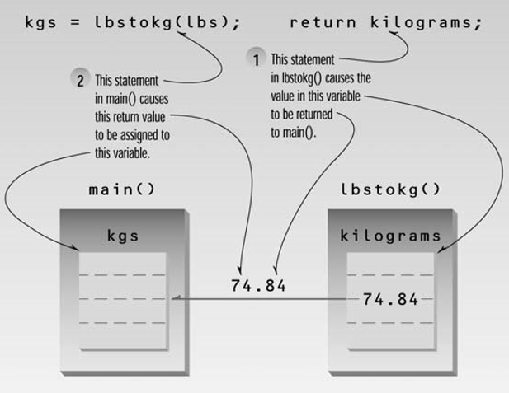
Returning value from a function – return statement

Slide 7
Reference Arguments
When arguments are passed by value, the called function creates a new variable of the same type as the argument and copies the argument’s value into it.
the function cannot access the original variable in the calling program, only the copy it created.
Passing arguments by value is useful when the function does not need to modify the original variable in the calling program

Slide 8
Reference Arguments
A reference provides an alias—a different name—for a variable.
Passing arguments by reference uses a different mechanism.
Instead of a value being passed to the function, a reference to the original variable, in the calling program, is passed. (It’s actually the memory address of variable that is passed)

Slide 9
Reference Arguments
A reference provides an alias—a different name—for a variable.
Passing arguments by reference uses a different mechanism.
Instead of a value being passed to the function, a reference to the original variable, in the calling program, is passed. (It’s actually the memory address of variable that is passed)

Slide 10
Overloaded Functions
An overloaded function appears to perform different activities depending on the kind of data sent to it.
Different number of arguments.
starline() function and the repchar() function had more or less same functionality.

Slide 11
Overloaded Functions
The starline() function printed a line using 45 asterisks
while repchar() used a character and a line length that were both specified when the function was called.
imagine a third function, charline(),that always prints 45 characters but that allows the calling program to specify the character to be printed.

Slide 12
Overloaded Functions
These three functions—starline(), repchar(), and charline()—perform similar activities but have different names.
that means three names to remember and three places to look them up if they are listed alphabetically in an application.
It would be far more convenient to use the same name for all three functions, even though they each have different arguments

Slide 13
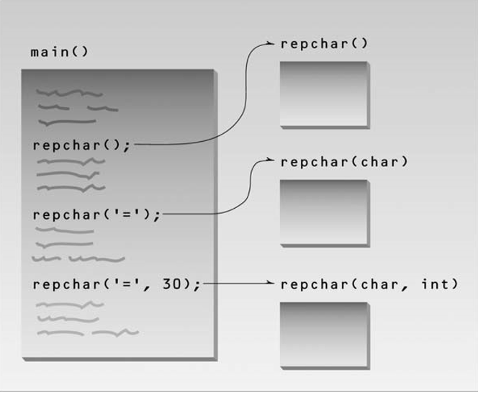
Overloaded Functions

Slide 14
Recursion
The existence of functions makes possible a programming technique called recursion.
Recursion involves a function calling itself

Slide 15
Inline Functions
functions save memory space because all the calls to the function cause the same code to be executed; the function body need not be duplicated in memory.
When the compiler sees a function call, it normally generates a jump to the function.
At the end of the function it jumps back to the instruction following the call
While this sequence of events may save memory space, it takes some extra time

Slide 16
Inline Functions
To save execution time in short functions, you may choose to put the code in the function body directly inline with the code in the calling program.
That is, each time there’s a function call in the source file, the actual code from the function is inserted, instead of a jump to the function.

Slide 17
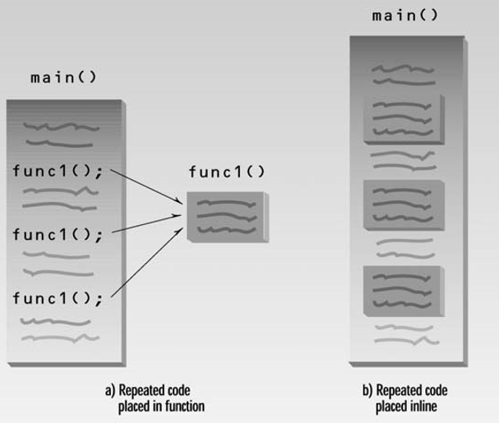
Inline Functions

Slide 18
Default arguments
a function can be called without specifying all its arguments

